Slide 1
How hot can a JPEG get?
Guide:
Philippe Charron
Participants:
Maor Ben Zaquen, Kfir Kaplan

Slide 2
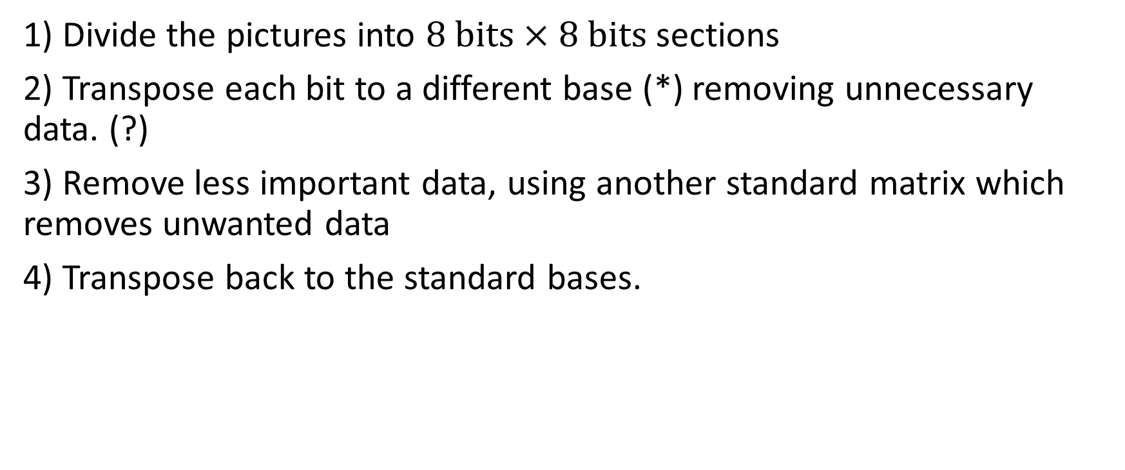
JPEG algorithm (JPEG 1)-
1) Divide the pictures into $8 bits×8 bits$ sections
2) Transpose each bit to a different base (*) removing unnecessary data. (?)
3) Remove less important data, using another standard matrix which removes unwanted data
4) Transpose back to the standard bases.

Slide 3
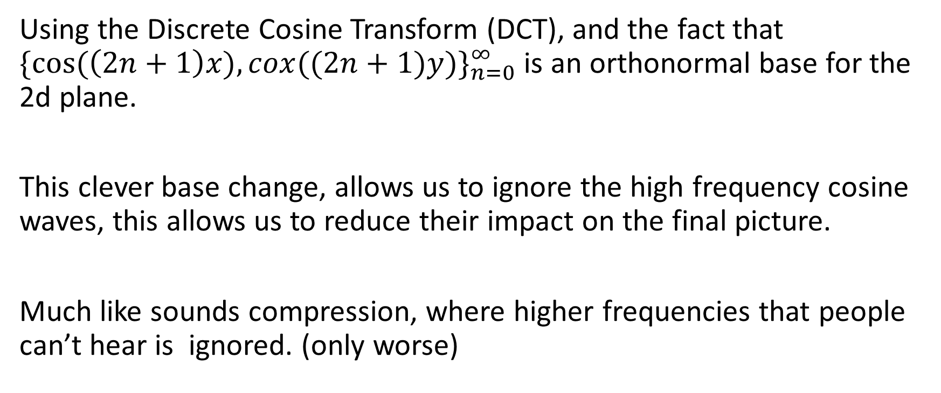
*Change of Basis
Using the Discrete Cosine Transform (DCT), and the fact that ${\{cos⁡(\left(2n+1\right)x),cox((2n+1)y)\}}_{n=0}^{∞}$ is an orthonormal base for the 2d plane.
This clever base change, allows us to ignore the high frequency cosine waves, this allows us to reduce their impact on the final picture.
Much like sounds compression, where higher frequencies that people can’t hear is ignored. (only worse)

Slide 4
Lossless and Lossy
Lossless compression is one where no data is lose
Lossy compression is one where data is lost
JPEG has to be a lossy, since to be efficient, data has to be ignored

Slide 5
The Problems with JPEG

Slide 7
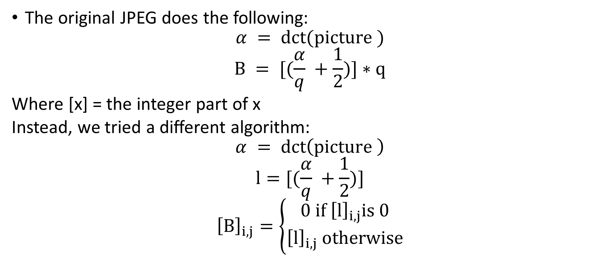
JPEG 2- using the original pictures coefficients
The original JPEG does the following:
$$α = dct(picture )$$
$$B = [(\frac{α}{q} +\frac{1}{2})]∗q$$
Where [x] = the integer part of x
Instead, we tried a different algorithm:
$$α = dct\left(picture \right)$$
$$l=[(\frac{α}{q} +\frac{1}{2})]$$
$${\left[B\right]}_{i,j}=\left\{\begin{aligned}0 if {\left[l\right]}_{i,j}is 0 \\ {\left[l\right]}_{i,j} otherwise\end{aligned}\right.$$

Slide 8
JPEG 3- change a the “ignoring” matrix
The original matrix used for ignoring the high frequency data was arbitrarily chosen to be:
10 | 16 | 22 | 28 | 34 | 40 | 46 | 52
16 | 22 | 28 | 34 | 40 | 46 | 52 | 58
22 | 28 | 34 | 40 | 46 | 52 | 58 | 64
28 | 34 | 40 | 46 | 52 | 58 | 64 | 70
34 | 40 | 46 | 52 | 58 | 64 | 70 | 76
40 | 46 | 52 | 58 | 64 | 70 | 76 | 82
46 | 52 | 58 | 64 | 70 | 76 | 82 | 88
52 | 58 | 64 | 70 | 76 | 82 | 88 | 94

Slide 9
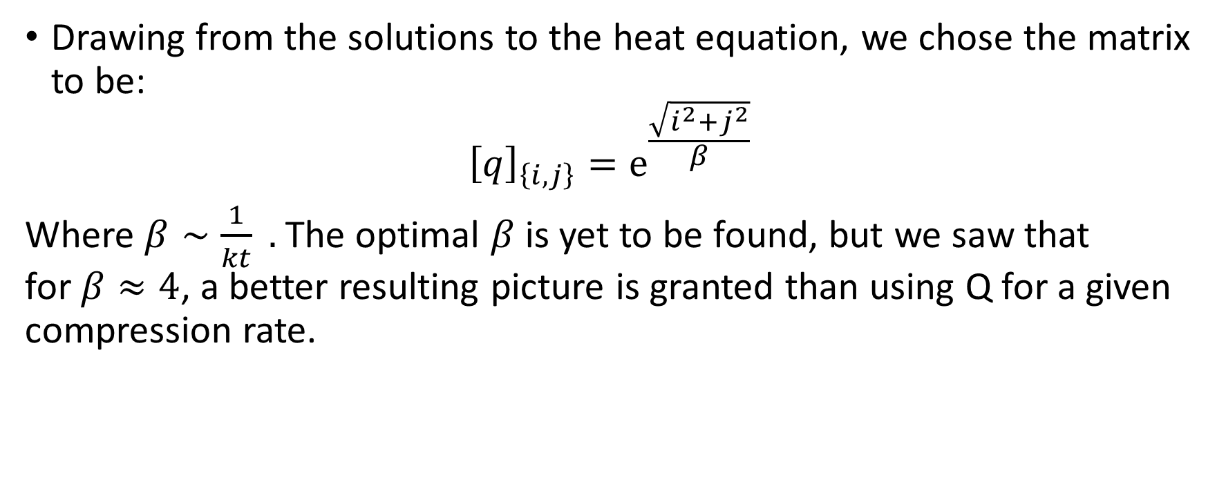
JPEG 3- change a the “ignoring” matrix
Drawing from the solutions to the heat equation, we chose the matrix to be:
$${\left[q\right]}_{\left\{i,j\right\}}=e^{\frac{\sqrt{i^{2}+j^{2}}}{β}}$$
Where $β∼\frac{1}{kt} .$The optimal $β$ is yet to be found, but we saw that for $β≈4$, a better resulting picture is granted than using Q for a given compression rate.

Slide 10
JEPG4-

